Slide 1
Machine Learning DASC 522
Neural Network Foundations & Processes
Dr. Torrey Wagner

Slide 2
Overview
Big Picture
Background & Structure
Perceptrons
Perceptron Learning
Multilayer Perceptrons (ANN or NN)
Backpropagation - NN Learning
Optimization

Slide 3
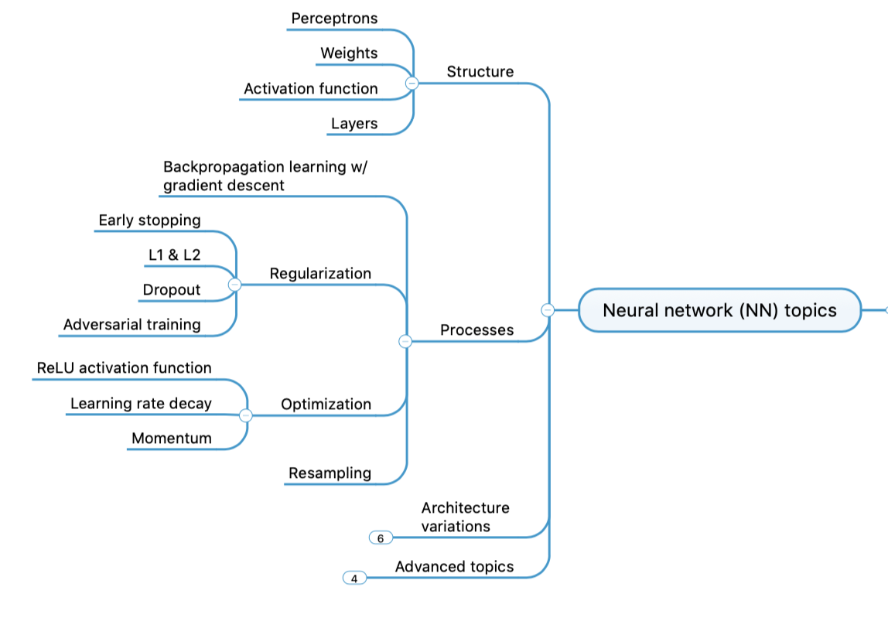
Concept Map - NN

Slide 4
Multilayer Perceptron
Perceptrons
ANNs
CNNs
RNNs

Slide 5
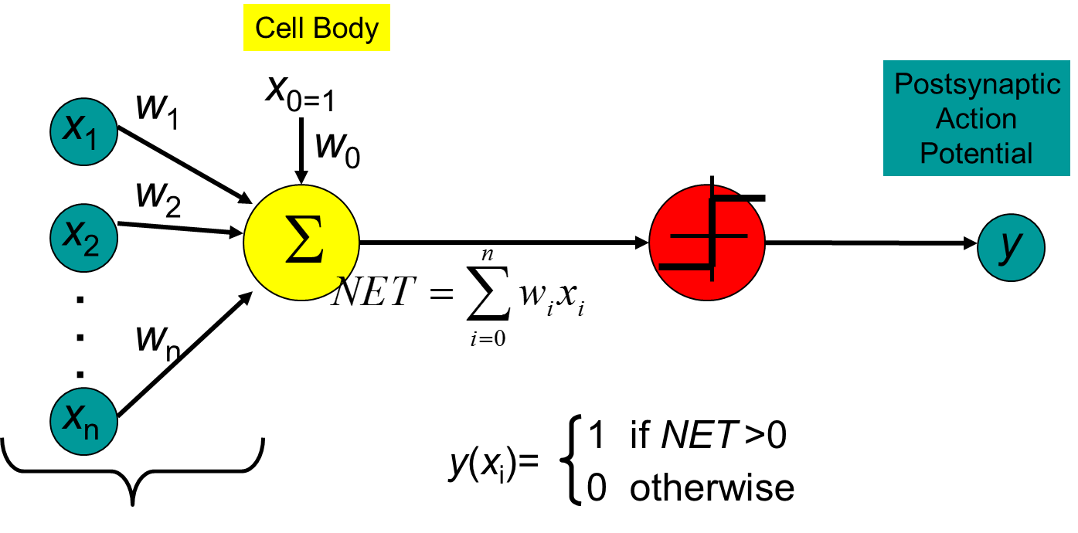
Limitations of single layer
Linear decisions only (e.g. cant solve XOR)
Regardless of activation function
Problems addressable by a single layer network are of limited interest, toy problems
Slide from Dr. Brett Borghetti, AFIT/ENG CSCE 823 Advanced Machine Learning, 2019SU

Slide 6
Early Demise of the Field
Perceptrons were beginning to be viewed as incapable learning machines that only sufficed for simple problems
Perceptron limitations made them unusable for practical problems – and the field turned away from ANNs
The general consensus was that the Multilayer perceptron should do better, but no theoretically-sound method to update the hidden layer weights was yet known
Slide from Dr. Brett Borghetti, AFIT/ENG CSCE 823 Advanced Machine Learning, 2019SU

Slide 7
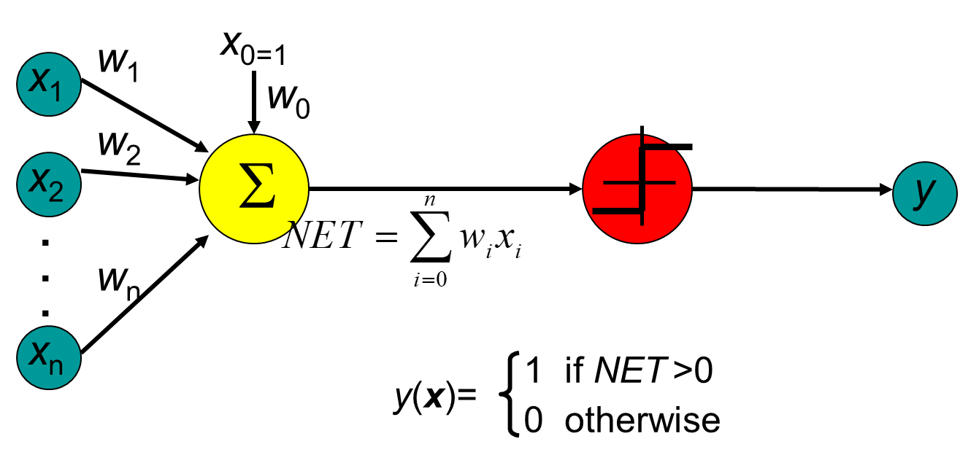

How do we make nonlinear classifiers out of perceptrons?
Build a multi-layer neural network!
http://slazebni.cs.illinois.edu/fall17/

Slide 8

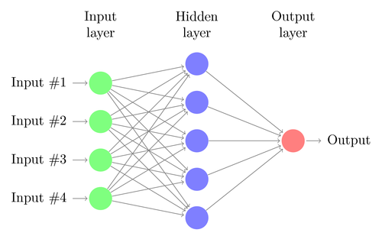
Hidden layer size and network capacity:
http://slazebni.cs.illinois.edu/fall17/
& http://cs231n.github.io/neural-networks-1/

Slide 9
Widrow’s Rule of Thumb
Widrows Rule of Thumb for classification
Relates # training samples to # weights and acceptable error
O = # of output classes
ε = Acceptable error (Real: 0 to 1)
W = # Weights in the network
P = # Training Samples Needed
Slide from Dr. Brett Borghetti, AFIT/ENG CSCE 823 Advanced Machine Learning, 2019SU

Slide 10
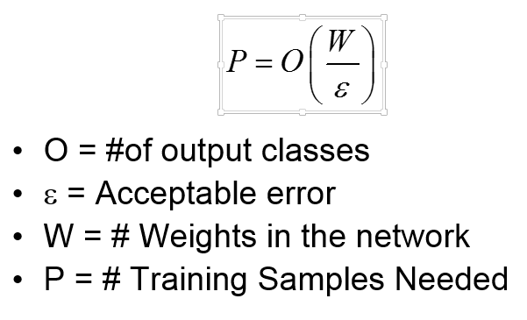
Widrow’s Rule of Thumb Example
Conditions
IRIS Dataset has 150 samples:
Input – 4-Dimensional
Output – 3 Classes
Acceptable error ~ 10%
Network: 1 Hidden layer (3 nodes), 1 output (1 node)
Compute:
# Weights = ____________
Number of samples needed: P = _____________
What if we use 2 hidden nodes? P = ?
Does this impact your training approach?
Slide from Dr. Brett Borghetti, AFIT/ENG CSCE 823 Advanced Machine Learning, 2019SU
Notes:
Input to hidden layer – 4*3 = 12
Hidden Layer to output layer – 3*3 = 9
Bias = #PEs less the input layer = 3 hidden + 3 output = 6
P = # Weights/ Acceptable Error = (12+9+6)/0.10 = 270
For 2 hidden PEs in the hidden layer, P = 190
The impact to the training approach is that you may have limits on your cross validation. You may to go to a leave one out strategy…

Slide 11
Hyperparameters
# neurons
# layers
Order of layers
Activation fn
Learning rate
epochs
https://towardsdatascience.com/model-parameters-and-hyperparameters-in-machine-learning-what-is-the-difference-702d30970f6
https://keras.io/api/layers/activations/

Slide 12
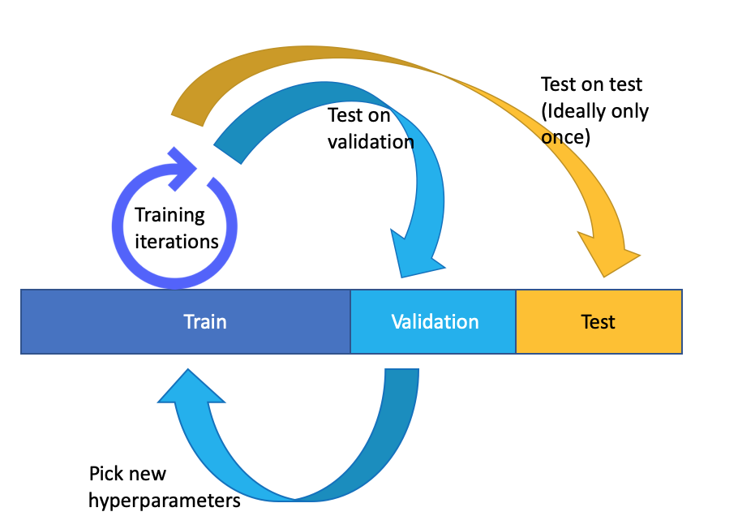
Hyperparameters
Notes:
Input to hidden layer – 4*3 = 12
Hidden Layer to output layer – 3*3 = 9
Bias = #PEs less the input layer = 3 hidden + 3 output = 6
P = # Weights/ Acceptable Error = (12+9+6)/0.10 = 270
For 2 hidden PEs in the hidden layer, P = 190
The impact to the training approach is that you may have limits on your cross validation. You may to go to a leave one out strategy…

Slide 13
Example - Siri
https://machinelearning.apple.com/_next/static/images/TrainingDNN-1-5660470c172c971e93241e10e858642e.png
Notes:
Input to hidden layer – 4*3 = 12
Hidden Layer to output layer – 3*3 = 9
Bias = #PEs less the input layer = 3 hidden + 3 output = 6
P = # Weights/ Acceptable Error = (12+9+6)/0.10 = 270
For 2 hidden PEs in the hidden layer, P = 190
The impact to the training approach is that you may have limits on your cross validation. You may to go to a leave one out strategy…

Slide 14
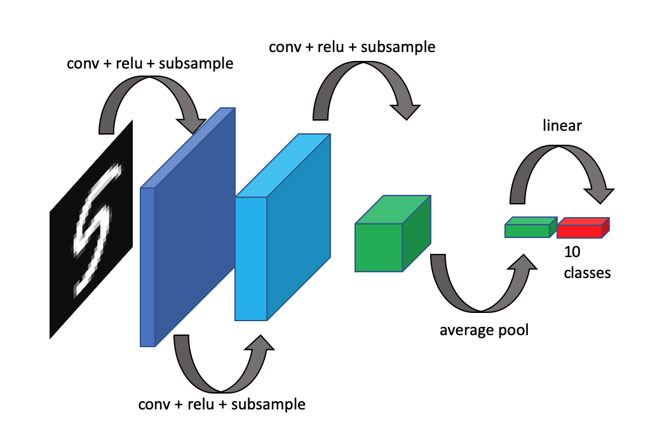
Example – Image recognition
Notes:
Input to hidden layer – 4*3 = 12
Hidden Layer to output layer – 3*3 = 9
Bias = #PEs less the input layer = 3 hidden + 3 output = 6
P = # Weights/ Acceptable Error = (12+9+6)/0.10 = 270
For 2 hidden PEs in the hidden layer, P = 190
The impact to the training approach is that you may have limits on your cross validation. You may to go to a leave one out strategy…

Slide 15
Example - Self-Driving Car
https://towardsdatascience.com/implementing-neural-network-used-for-self-driving-cars-from-nvidia-with-interactive-code-manual-aa6780bc70f4
Notes:
Input to hidden layer – 4*3 = 12
Hidden Layer to output layer – 3*3 = 9
Bias = #PEs less the input layer = 3 hidden + 3 output = 6
P = # Weights/ Acceptable Error = (12+9+6)/0.10 = 270
For 2 hidden PEs in the hidden layer, P = 190
The impact to the training approach is that you may have limits on your cross validation. You may to go to a leave one out strategy…

Slide 16
AlphaGo Zero
https://medium.com/applied-data-science/alphago-zero-explained-in-one-diagram-365f5abf67e0
Notes:
Input to hidden layer – 4*3 = 12
Hidden Layer to output layer – 3*3 = 9
Bias = #PEs less the input layer = 3 hidden + 3 output = 6
P = # Weights/ Acceptable Error = (12+9+6)/0.10 = 270
For 2 hidden PEs in the hidden layer, P = 190
The impact to the training approach is that you may have limits on your cross validation. You may to go to a leave one out strategy…

Slide 17
Example - AlphaGo Zero
https://medium.com/applied-data-science/alphago-zero-explained-in-one-diagram-365f5abf67e0
Notes:
Input to hidden layer – 4*3 = 12
Hidden Layer to output layer – 3*3 = 9
Bias = #PEs less the input layer = 3 hidden + 3 output = 6
P = # Weights/ Acceptable Error = (12+9+6)/0.10 = 270
For 2 hidden PEs in the hidden layer, P = 190
The impact to the training approach is that you may have limits on your cross validation. You may to go to a leave one out strategy…

Slide 18
https://towardsdatascience.com/the-mostly-complete-chart-of-neural-networks-explained-3fb6f2367464
Notes:
Input to hidden layer – 4*3 = 12
Hidden Layer to output layer – 3*3 = 9
Bias = #PEs less the input layer = 3 hidden + 3 output = 6
P = # Weights/ Acceptable Error = (12+9+6)/0.10 = 270
For 2 hidden PEs in the hidden layer, P = 190
The impact to the training approach is that you may have limits on your cross validation. You may to go to a leave one out strategy…

Slide 19
Simple NNs are Valuable Too!

Slide 20
Machine Learning DASC 522
Neural Network Foundations & Processes
Dr. Torrey Wagner

Slide 21
Overview
Big Picture
Background & Structure
Perceptrons
Perceptron Learning
Multilayer Perceptrons (ANN or NN)
Backpropagation - NN Learning
Optimization

Slide 22
Backpropagation
Perceptrons
ANNs
CNNs
RNNs

Slide 23
Concept Map - NN

Slide 24
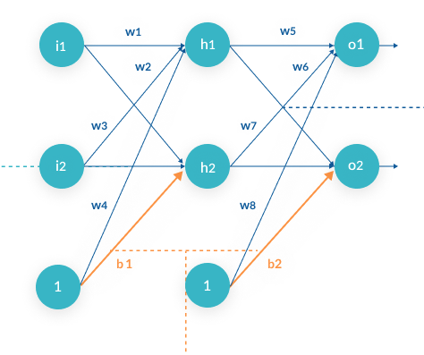
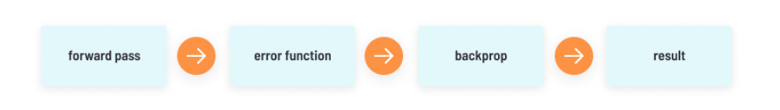
Backpropagation
https://missinglink.ai/guides/neural-network-concepts/backpropagation-neural-networks-process-examples-code-minus-math/

Slide 25
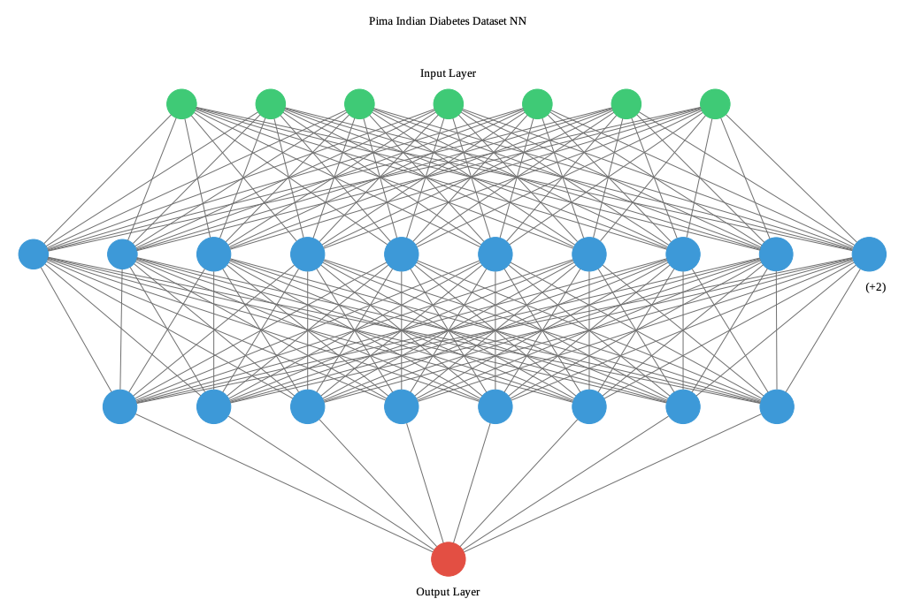
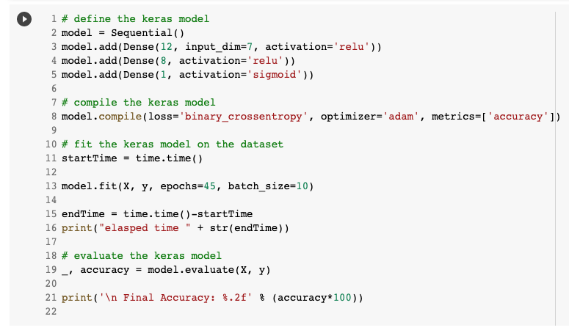
Backpropagation Speed

Slide 26
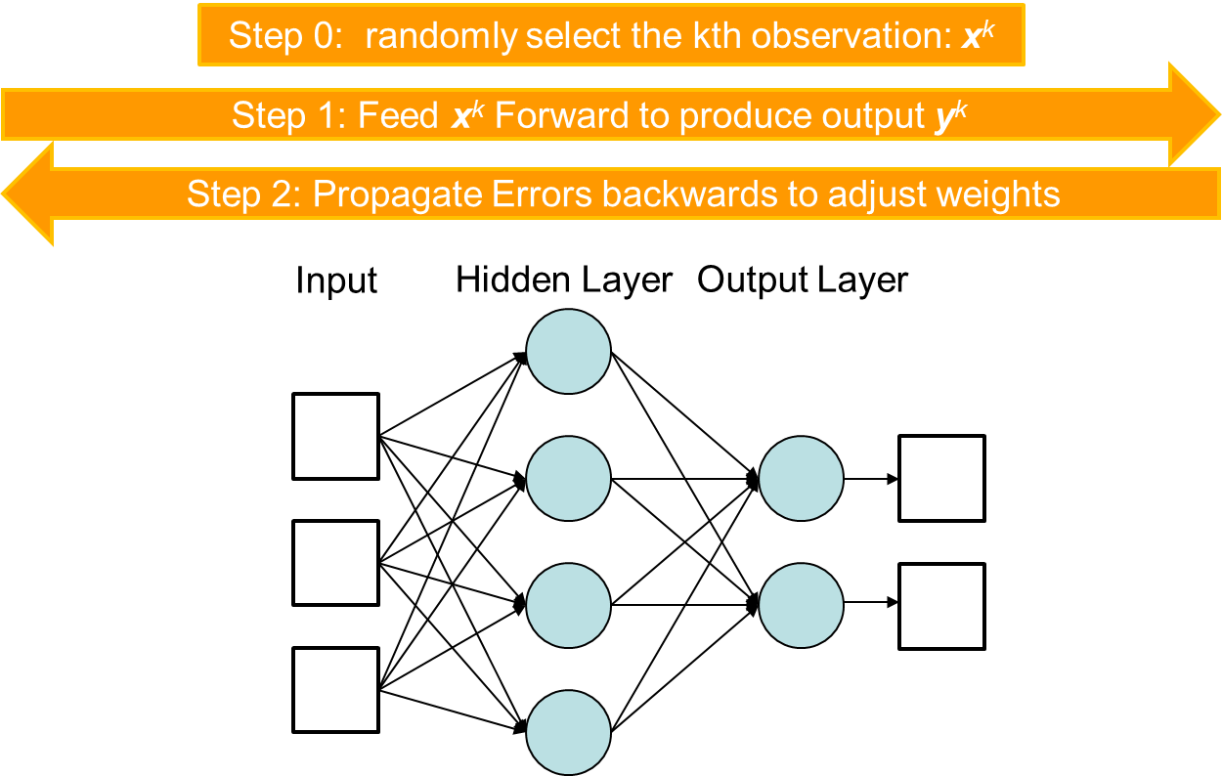
Backpropagation
Fundamental training procedure to adjust ANN weights
Weights are updated according to their contribution toward the error
Slide from Dr. Brett Borghetti, AFIT/ENG CSCE 823 Advanced Machine Learning, 2019SU

Slide 27
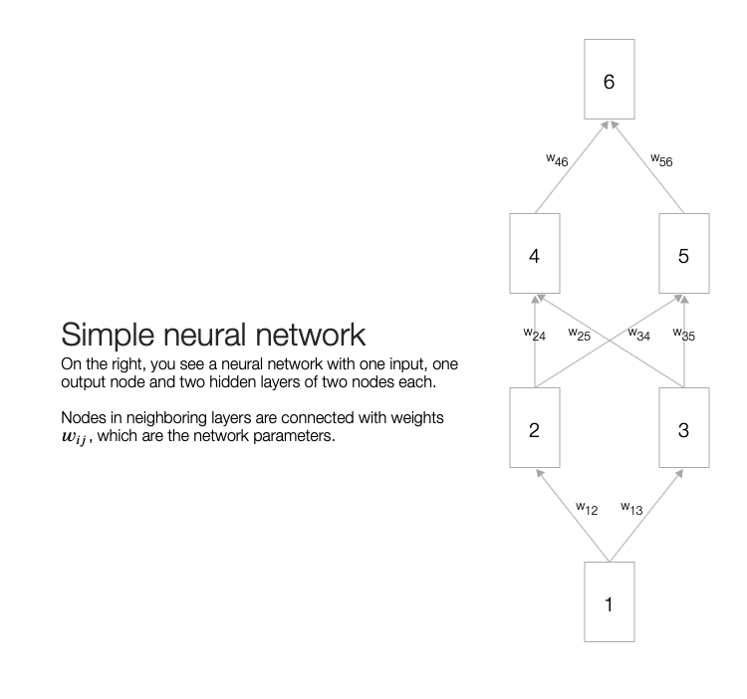
Backpropagation Animation
https://developers-dot-devsite-v2-prod.appspot.com/machine-learning/crash-course/backprop-scroll?authuser=1

Slide 28
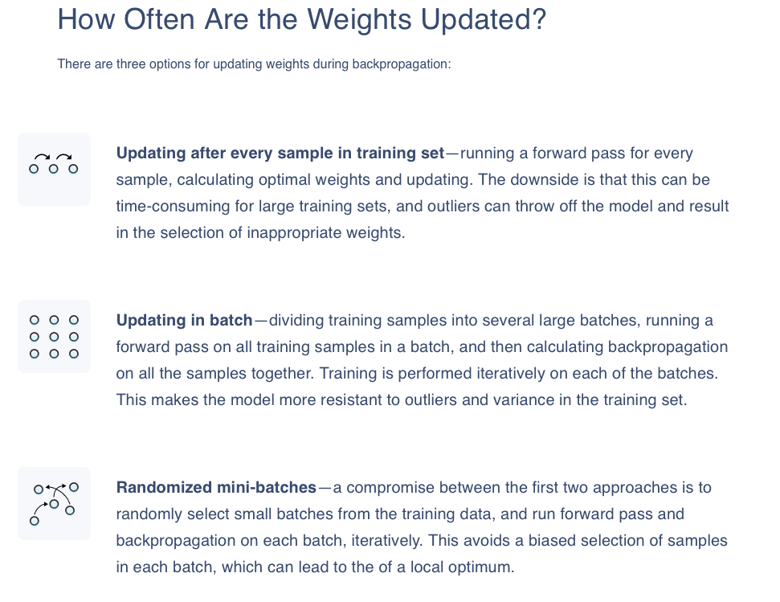
Improving Training Performance
https://missinglink.ai/guides/neural-network-concepts/backpropagation-neural-networks-process-examples-code-minus-math/
https://keras.rstudio.com/reference/fit.html

Slide 29
Problem with stopping based on training performance
If we train until training performance stops improving
We might be overfitting
We cannot revert to previous state of weights
It may be infeasable to retain all the weights for every training iteration
How do we solve this?
Stop training when error goes up on validation set
Known as “Early Stopping”
Modern network training software often has built in methods to handle this
Slide from Dr. Brett Borghetti, AFIT/ENG CSCE 823 Advanced Machine Learning, 2019SU

Slide 30
Keras Early Stopping Demonstration

